Slide 1
Welcome to
Kansas State
Psychological Sciences
Research Lab Opportunities
Come Be A Part of Research!
We have over 15 research labs you can volunteer in.
We currently have about 100 students working in research labs.

Slide 2
Kansas State Psychological Sciences studies 4 areas of Psychological Sciences.
Behavioral Neuroscience
Cognitive/ Human Factors
Social/ Personality
Industrial/ Organizational
Behavioral Neuroscience
Behavioral Neuroscience is the study of how behavior is shaped by structures and chemicals in the brain.
Cognitive/ Human Factors
Cognitive/ Human Factors is the study of how people’s minds process information to perceive and act adaptively.
Industrial/ Organizational
Industrial/ Organizational is the study of how to effectively apply psychological insights to the workplace.
Social/ Personality
Social/ Personality is the study of how people interact with each other and how individuals differ.

Slide 3
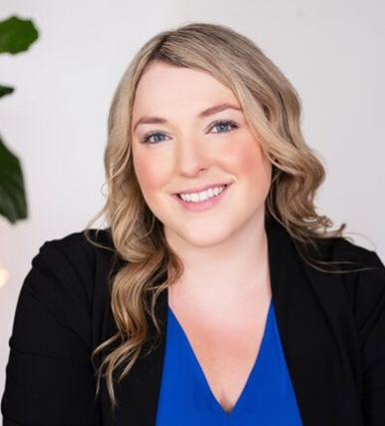
Behavioral Neuroscience
Cognitive/ Human Factors
Industrial/ Organizational
Social/ Personality
Studies areas of support behavior at work, including the trickle-down effects of supervisor perceptions of co-worker support and its impact on employee well-being in and out of the office.
Supportive Behaviors at Work
Work-Family Enrichment
Individual Well-Being
Shalene Allen Assistant Professor
Support Interventions

Slide 4
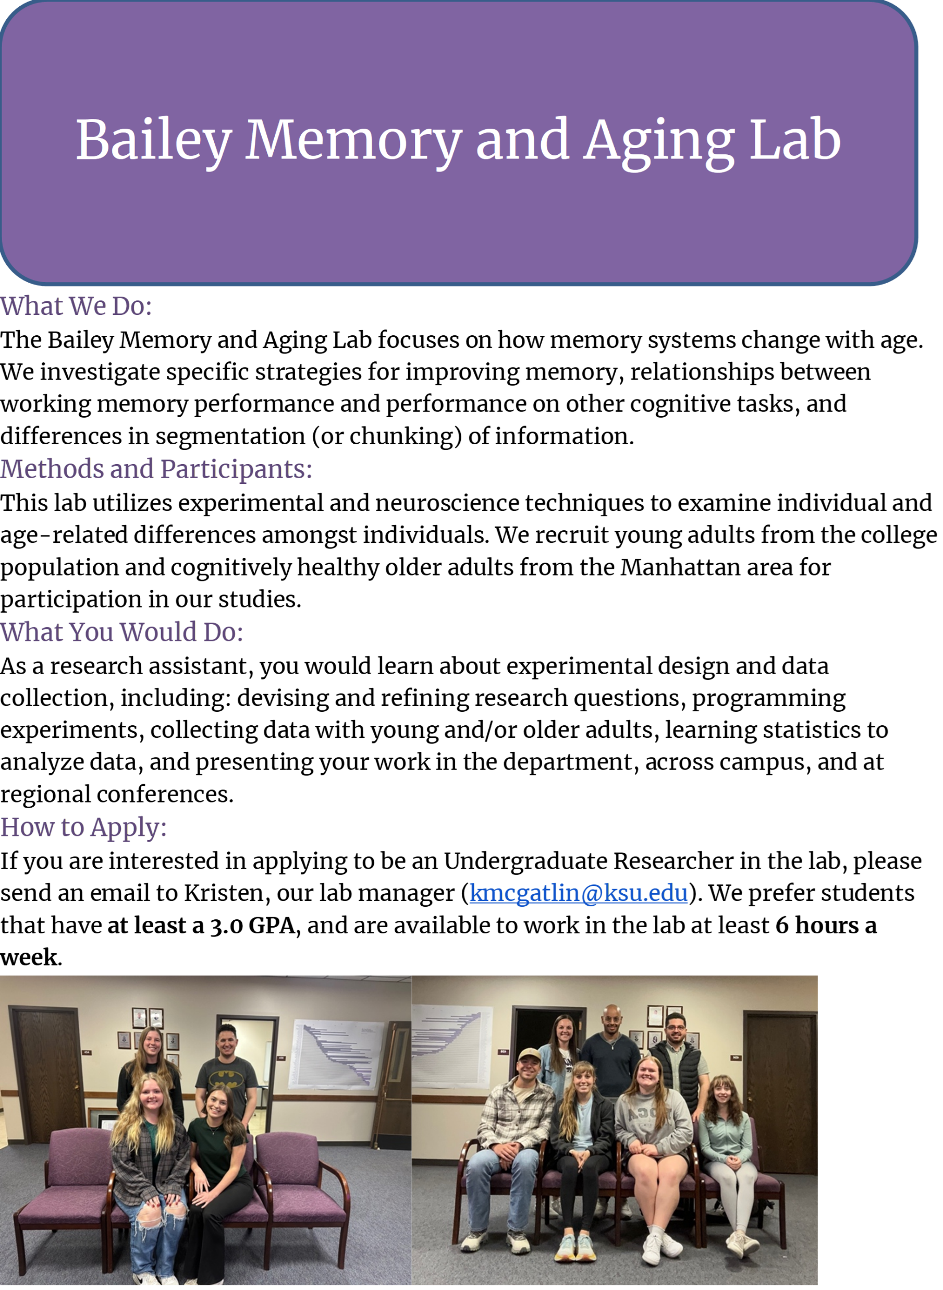
Dr. Heather Bailey Associate Professor
Behavioral Neuroscience
Cognitive/ Human Factors
Industrial/ Organizational
Social/ Personality
Dr. Bailey’s research focuses on how memory differs across individuals and how it changes with age.
Working memory
Event segmentation
learning

Slide 5
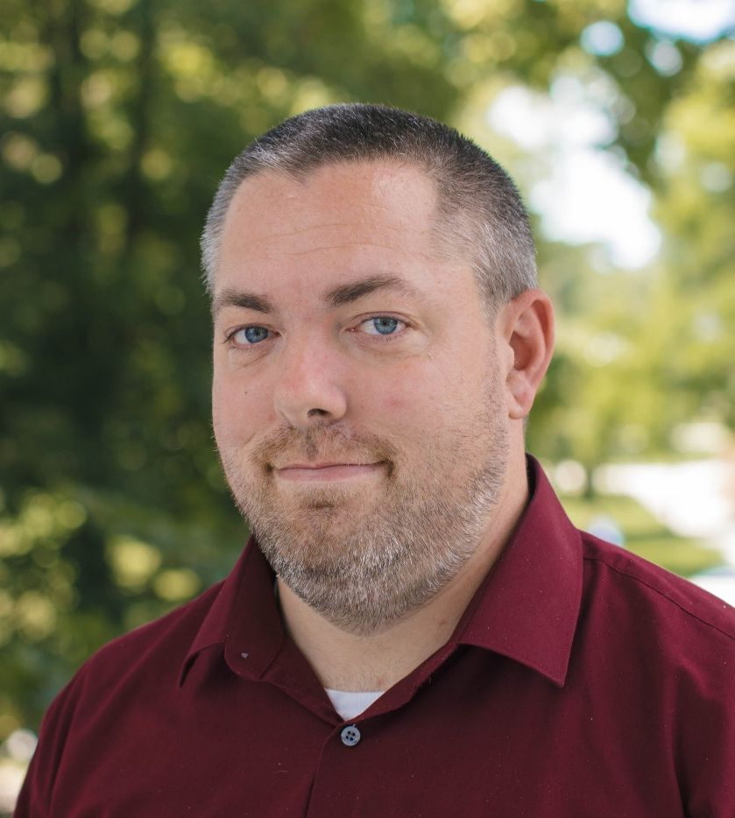
Behavioral Neuroscience
Cognitive/ Human Factors
Industrial/ Organizational
Social/ Personality
In the Aggression Research Laboratory (ARL), we study the antecedents and consequences of aggressive behavior (broadly defined).
Cyberbullying
Violence Prevention
Individual Differences
Theory Development
Dr. Christopher Barlett Assistant Professor
Health Behaviors

Slide 6
Dr. Natalie Barlett Teaching Assistant Professor
Behavioral Neuroscience
Cognitive/ Human Factors
Industrial/ Organizational
Social/ Personality
The Barlett Development Lab explores how movement through emerging adulthood can impact one’s personality, psychological well-being and physical health.
Development in Early/Emerging Adulthood
Individual Differences
Health
Identity

Slide 7
Dr. Laura Brannon Professor
Behavioral Neuroscience
Cognitive/ Human Factors
Industrial/ Organizational
Social/ Personality
In the bapl, we study how people form attitudes, how they can be changed, and how that affects their behavior.
Persuasion (promoting positive physical & mental health)
Positive Psychology (promoting prosocial behavior)

Slide 8
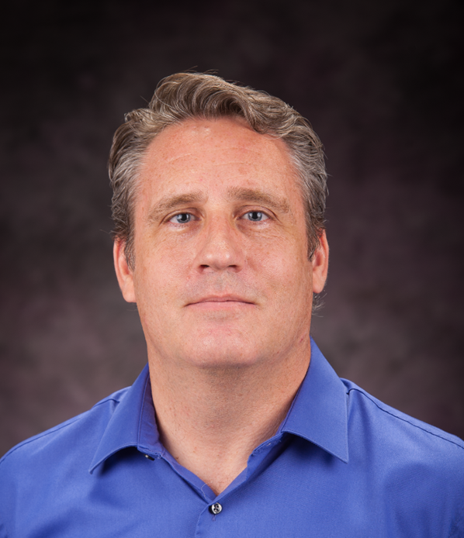
Dr. Gary Brase Professor Associate Department Head
Behavioral Neuroscience
Cognitive/ Human Factors
Industrial/ Organizational
Social/ Personality
We do studies on how people make judgments and decisions across different real-life situations.
Judgement and Decision Making
Social and Statistical Reasoning
Evolutionary Psychology

Slide 9
Dr. Mary Cain Professor
Behavioral Neuroscience
Cognitive/ Human Factors
Industrial/ Organizational
Social/ Personality
In the cain lab we use animal models of early life environmental differences to unravel the underlying mechanisms of addiction and addiction vulnerability.
Neurobiology of Addiction
Differential Rearing
Novelty & Individual Differences

Slide 10
Dr. Maria Diehl Faryna Assistant Professor
Behavioral Neuroscience
Cognitive/ Human Factors
Industrial/ Organizational
Social/ Personality
The diehl laboratory seeks to understand why some individuals can overcome trauma and develop behavioral resilience, while others may develop a neuropsychiatric disease, such as post-traumatic stress disorder.
Neural Circuits of Fear & Avoidance
Behavioral Resilience
Social Interactions

Slide 11
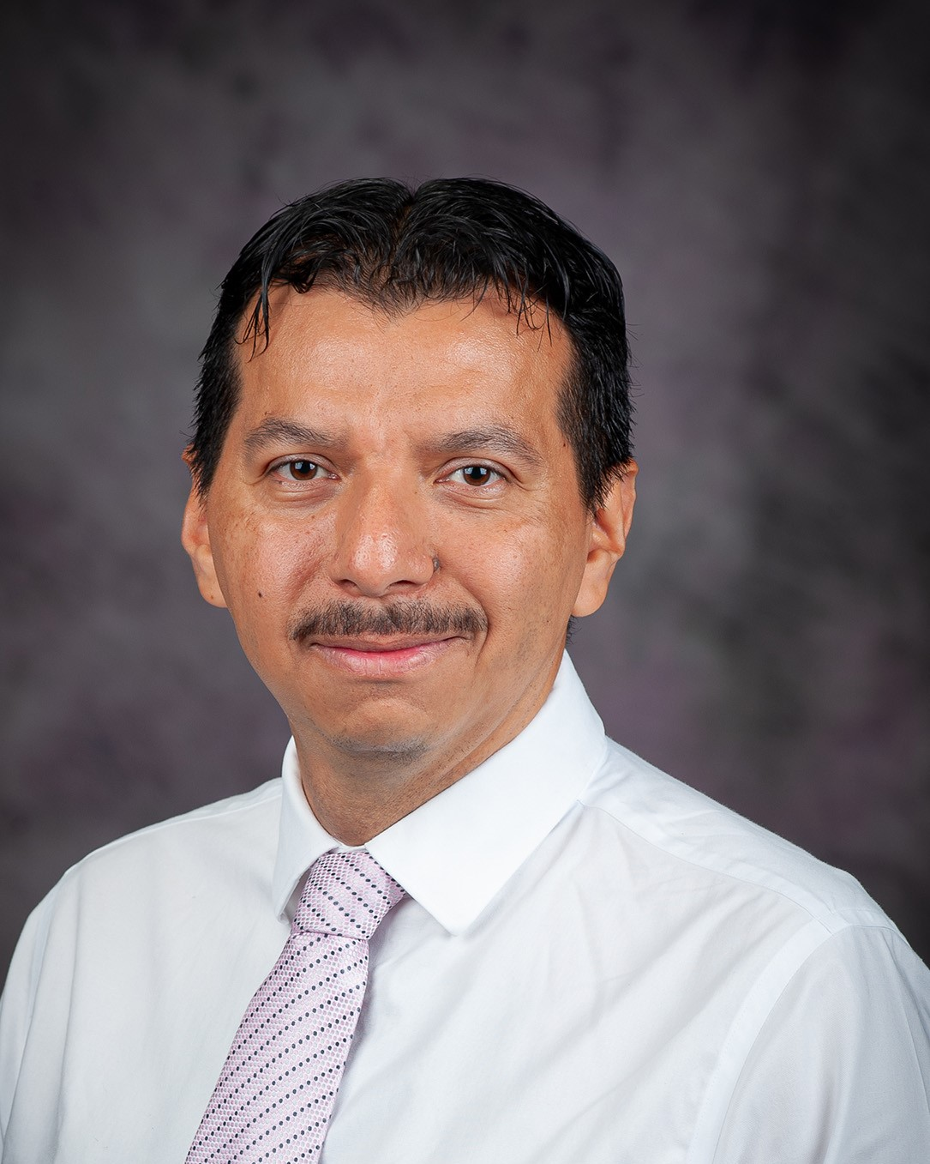
Dr. Julio Hernandez Pavon Assistant Professor
Behavioral Neuroscience
Cognitive/ Human Factors
Industrial/ Organizational
Social/ Personality
DEVELOPING NEW APPROACHES TO MODULATE BRAIN CONNECTVIITY AND INDUCE NEUROPLASTICITY USING BRAIN IMAGING AND STIMULATION WITH BOTH EEG AND TMS TECHNIQUES.
Brain Stimulation
Clinical Neuroscience
Electroencephalography (EEG) & Transcranial Magnetic Stimulation (TMS)

Slide 12
Behavioral Neuroscience
Cognitive/ Human Factors
Industrial/ Organizational
Social/ Personality
CONDUCTS RESEARH ON HOW PHYSICAL CONTACT (E.G., HUGGING) IS RELATED TO ATTACHMENT STYLES, GENDER, AND PHYSICAL AND MENTAL HEALTH. ALSO INTERESTED IN SOCIAL INFLUENCE, RELATIONSHIPS, AND FUNCTION OF BEHAVIORS SUCH AS ADULT CRYING, TICKLING, AND SWEARING.
Physical contact
Attachment styles
Social influence
Dr. Carrie lane Teaching assistant Professor
Gender differences

Slide 13
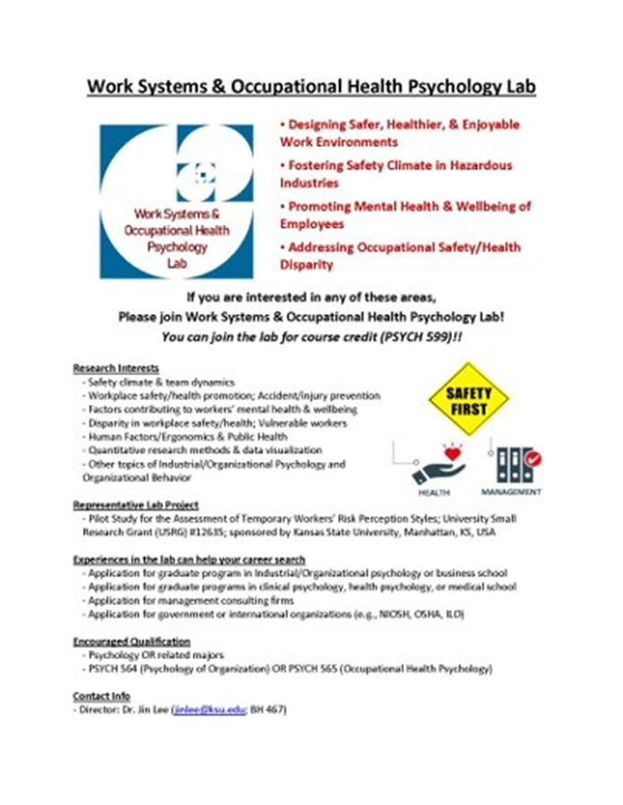
Dr. Jin Lee Associate Professor
Behavioral Neuroscience
Cognitive/ Human Factors
Industrial/ Organizational
Social/ Personality
Our lab is focused on designing safe, healthier, and enjoyable work environments.
Occupational Health Psychology
Ergonomics
Quantitative Research Methods

Slide 14
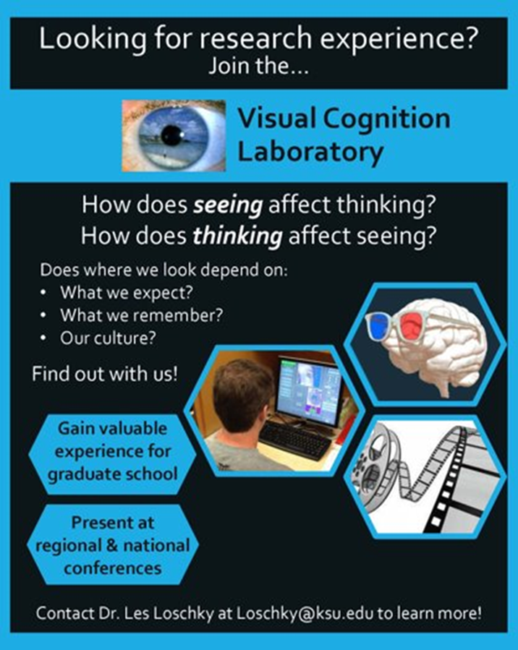
Dr. Les Loschky Professor
Behavioral Neuroscience
Cognitive/ Human Factors
Industrial/ Organizational
Social/ Personality
The visual cognition laboratory conducts research on scene perception and its real-world applications, spanning the traditional areas of perception and cognition.
Visual Cognition
Human-Computer Interaction & Comprehension

Slide 15
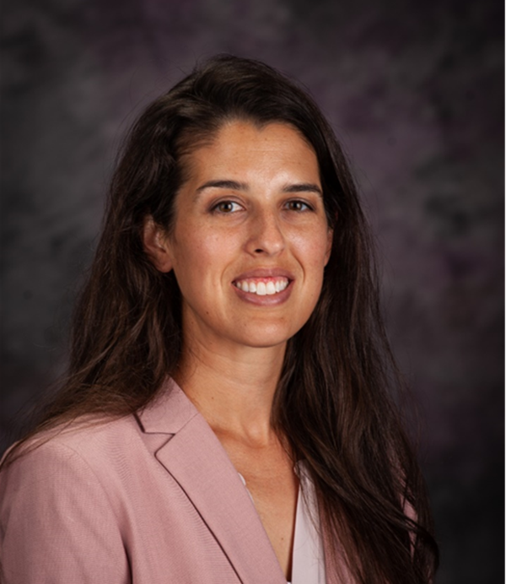
Dr. Sarina Maneotis Teaching Assistant Professor MIOP Director
Behavioral Neuroscience
Cognitive/ Human Factors
Industrial/ Organizational
Social/ Personality
Dr. Maneotis Research Lab
Prosocial Motivation & Behavior
Work/Non-Work Interface
Assessment

Slide 16
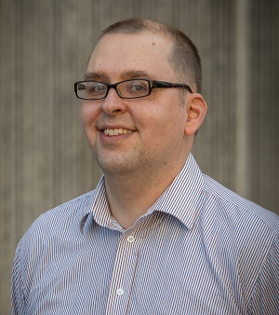
Behavioral Neuroscience
Cognitive/ Human Factors
Industrial/ Organizational
Social/ Personality
The cognition, learning, and psychopharmacology lab is interested in the relationship between drug use (including alcohol & illegal drugs) and learning abilities in a variety of tasks.
Psychopharmacology
Drugs of Abuse
Learning
Dr. Charles Pickens Associate Professor
Conditioning
Decision-Making

Slide 17
Dr. Bethany Plakke Anderson Assistant Professor
Behavioral Neuroscience
Cognitive/ Human Factors
Industrial/ Organizational
Social/ Personality
We examine cognitive flexibility & multisensory processing with neurophysiological & histological techniques to determine neural circuits of sensation and cognition
Multisensory and Audiovisual Processing
Learning and Memory
Auditory Discrimination

Slide 18
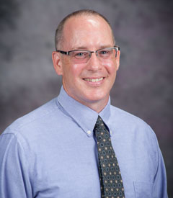
Behavioral Neuroscience
Cognitive/ Human Factors
Industrial/ Organizational
Social/ Personality
Dr. Saucier’s research interests center on expressions of antisocial and prosocial behavior.
Prejudice & Antisocial Behavior
Group Slurs & Humor
Masculine Honor
Social Vigilantism
Dr. Don Saucier Professor

Slide 19
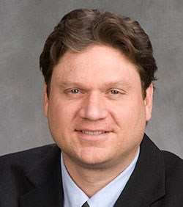
Dr. David Schmitt Professor Department Head
Behavioral Neuroscience
Cognitive/ Human Factors
Industrial/ Organizational
Social/ Personality
RESEARCH FOCUSED ON PERSONALITY AND MENTAL HEALTH DIFFERENCES ACROSS GENDERS, CULTURES, & HISTORICAL TIME PERIODS.
Personality
Health
Well-Being
Cross-Cultural Intersections of Gender, sex, and sexuality

Slide 20
Behavioral Neuroscience
Cognitive/ Human Factors
Industrial/ Organizational
Social/ Personality
RESEARCH FOCUSED ON HOW FAMILY AND ROMANTUC RELATIONSHIPS ARE IMPACTED AND MODERATED BY TECHNOLOGY USE AND HOW PEOPLE ARE CREATING INTIMACY WITH ARTIFICAL INTELLIGENCE APPLICATIONS.
Family
Romantic relationships
Technology use
Dr. Jennifer Smith Teaching Assistant Professor
Contextualism

Slide 21
Behavioral Neuroscience
Cognitive/ Human Factors
Industrial/ Organizational
Social/ Personality
Our lab works toward improving methodological standards of workplace assessment using collateral information in the testing environment.
Research Methods
Noncognitive Assessments
Reducing Response Bias
Naidan Tu Assistant Professor
Adaptive Testing

Slide 22
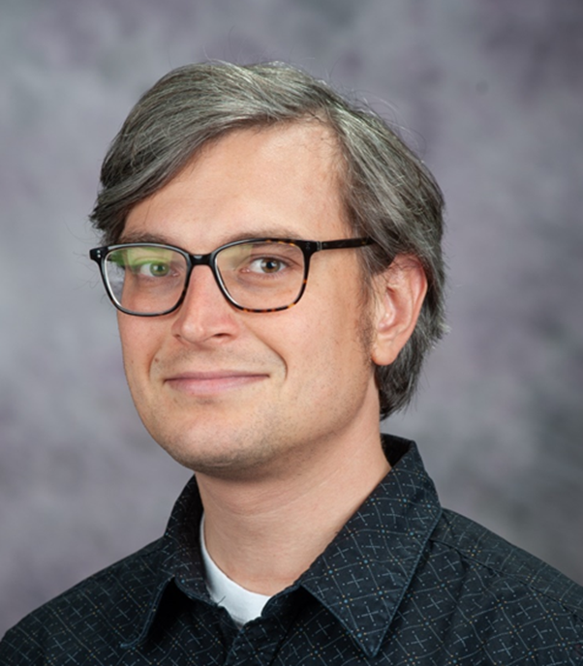
Dr. Matthew Wizniewski Associate Professor
Behavioral Neuroscience
Cognitive/ Human Factors
Industrial/ Organizational
Social/ Personality
In the ALC lab at K-State, behavioral, electroencephalogram (EEG) recording, and connectionist modeling methods are used to study the processes involved in auditory perceptual learning.
Auditory Learning & Cognition
EEG

Slide 23
Behavioral Neuroscience
Cognitive/ Human Factors
Industrial/ Organizational
Social/ Personality
Research typically involves the study of decision making in dynamic environments.
Judgement and Decision-Making
Human-Computer Interaction
Dr. Michael Young Professor

Slide 24
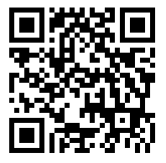
Where do you find more information?
How do you join a lab?
What joining a lab can do for your college experience?
Explore our website for more information:
https://www.k-state.edu/psych/undergraduate/

